Slide 1



Team America Yee Haw
By: Gabe Goodman, Eric Grant, Derrell Reynolds, Shawn Lewin, Israel Lannin, Nolan Yanick.

Slide 2

Adobe develops digital editing software.
Their headquarters is in San Jose, CA.
They provide a wide variety of jobs to many programming related fields.

Slide 3
Comp Science
Comp Engineer
Mathematics
Statistics
Bachelors
Masters
PHD

Slide 4
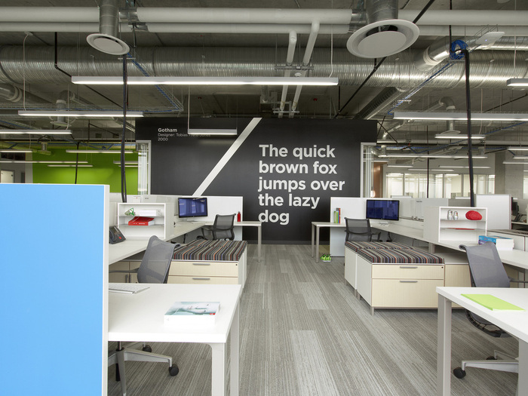
Adobe provides sleek modern office spaces for employees.

Slide 5
Adobe has a high salary that can range between $100k and $160k on average and great benefits.
The company and their CEO, Shantanu Narayen, have positive reputations.

Slide 6

Amazon
Domain: https://www.amazon.com
Amazon is the leading E-commerce company in revenue, 135.99 billion dollars last year.
Online retailer
Cloud computing
Online bookstore
Books
DVDs
Blurays

Slide 7
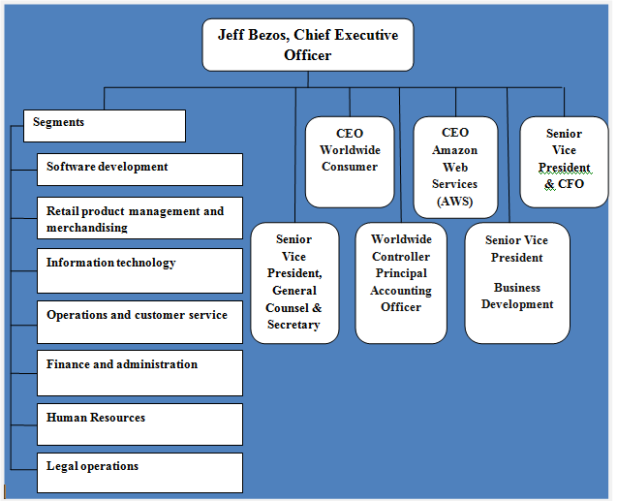
Amazon headquarters is located in Seattle, Washington. There are major distribution centers all over the world.
Each region has a local online store with its own top-level domain and a country code.
United States - Amazon.com
China - Amazon.cn
France - Amazon.fr
https://research-methodology.net/amazon-organizational-structure-2/

Slide 8

Some of the common tech jobs found at Amazon are:
IT Technicians
IT Systems Engineer
Network Engineer
Technical Support Engineer
Network Support Engineer
Cloud Support Engineer

Slide 9
Hired 110,000 employees last year company wide
Plan on hiring another 288,000 employees worldwide within the next 18 months.
Restitution:
Promotions
Benefits
Salary
Work/Life Balance
Notes:
Medical, prescription drug, dental and visioncoverage. 401(k) savings plan

Slide 10

Airbnb specializes in in travel accommodations and hospitality services, offering people the option to rent or lease out their home, apartment, cabin, condo, etc. to travelers from around the globe.
Currently, Airbnb is headquartered in San Francisco, California.
Airbnb is organized into many different departments, including marketing, legal, customer service, engineering, etc. Overseeing those departments is there CEO and co-founder, Brian Chesky. Each department is made up of relatively small teams as well.

Slide 11
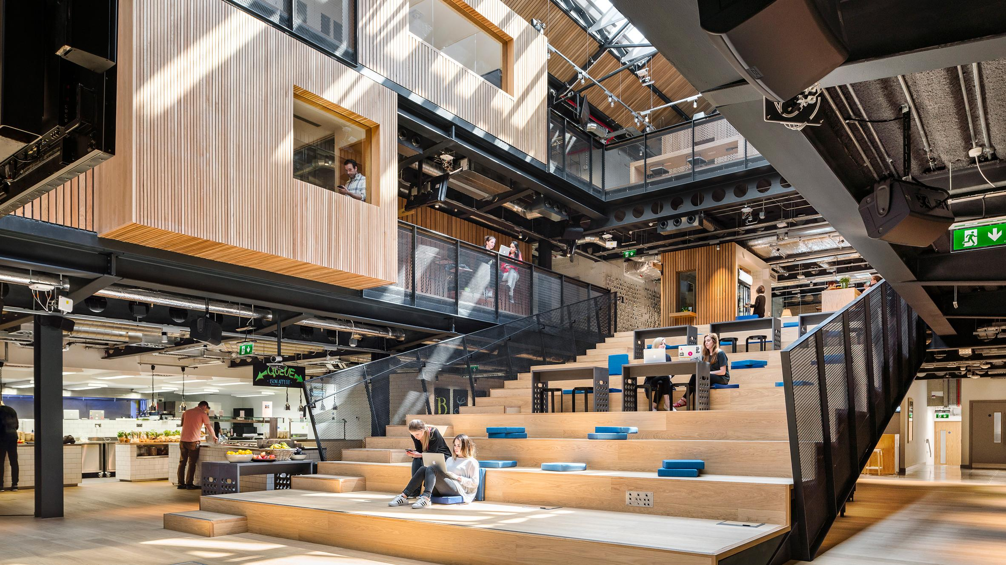


Careers
Airbnb offers many technological jobs to potential employees. Jobs range in categories like engineering, data analysis, design, and information technology.
Overall, the work environment provided by Airbnb is exceptional. Many current and former employees list it as one of the best perks to working there.

Slide 12

Careers - Continued
Airbnb has built a solid reputation for themselves so far. Generally, employees rate working at Airbnb relatively high.
According to Glassdoor.com, 71% of employees would recommend to a friend and about 87% employees approve of the CEO.
Salaries for the tech employees are also relatively deserving and satisfiable. A general range for all the tech jobs available at Airbnb would be about $70k - $230k per year.

Slide 13

Twitter's Mission
Twitter is an International Social Media Source that is used by Millions of different users and companies every day.
CEO: Jack Dorsey
CMO & Head of People: Leslie Berland
GM: Kayvon Beykpour
GM & Revenue Product and Engineering: Bruce Falck
General Counsel: Vijaya Gadde
GM & Consumer Product/Engineering: Ed Ho
VP & Design/User Research: Grace Kim
COO: Anthony Noto
CFO: Ned Segal
“Give everyone the power to create and share ideas and information instantly, without barriers.”

Slide 14
2.The Type of Tech Jobs supported by Twitter
Data Science & Analytics: works on core systems and engineering machine learning. As well as Data licensing and streaming API products.
Infrastructure Engineering: Design hardware, networks, and Data centers. Staying ahead of the competition with its infrastructure services and tools.
Product: From taking a idea to the market to designing accessible and intuitive user experiences.
Software Engineering: Works on aspects the touch every part of Twitter as a product. Working along with designers and project managers.
And many many more jobs.

Slide 15
3.How does Twitter do a an workzas a company?
A Senior Product Manager is predicted to make a salary between $146 to $206 according to glassdoor.com. Twitter has over 200 job openings! They are continuously hiring new students coming out of colleges. Their work environment in teams each working towards different goals. Their Headquarters is located in San Francisco, California. But it has offices located globally.

Slide 16
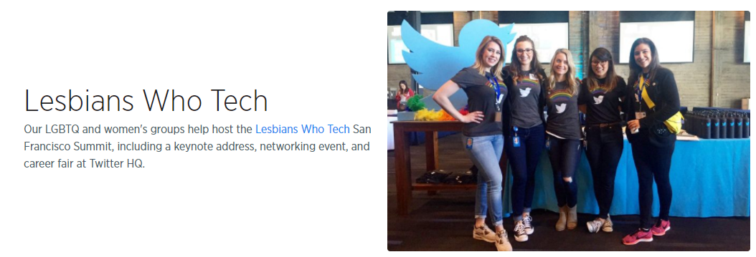
4. Twitter's Inclusiveness
Twitter is very inclusive of all its employees. Hiring people from all walks of life. They believe that our differences make us stronger. Being supportive towards those of different Race, Gender, or Beliefs.
https://careers.twitter.com/en/diversity.html

Slide 17
5.Twitter Benefits
On Glassdoor.com there are 656 reviews. Of those reviews Twitter receives a 4.4/5 for the benefits it provides. Many people on Glassdoor.com claim that Twitter has a very basic healthcare plan and does not provide anything special compared to other companies.
https://twitter.com/Twitter?ref_src=twsrc%5Egoogle%7Ctwcamp%5Eserp%7Ctwgr%5Eauthor

Slide 18

1. What they do
https://en.wikipedia.org/wiki/Oracle_Corporation#/media/File:Oracle_logo.svg
Oracle is a software company focused on database and enterprise cloud computing software.
Software as a Service
Platform as a Service
and Infrastructure as a Service

Slide 19
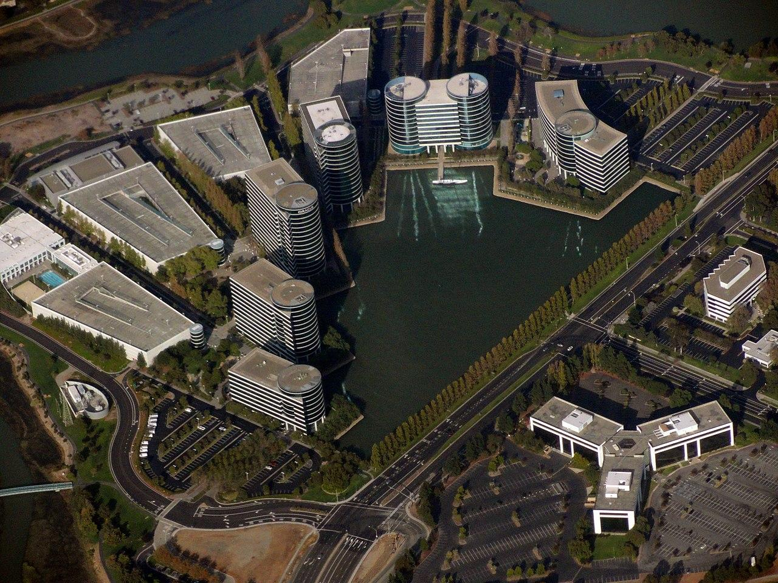
2. How they do it
Oracle has over 40000 employed Software developers and engineers,
and 16000 support and service specialists.
Main campus: Redwood Shores, California
All over the world
https://en.wikipedia.org/wiki/Oracle_Corporation#/media/File:Oracle_logo.svg

Slide 20
4. Job Employment
Oracle’s own website
6k jobs, 300 of them IT
College recruiting
Compensation
Housing
Transportation

Slide 21

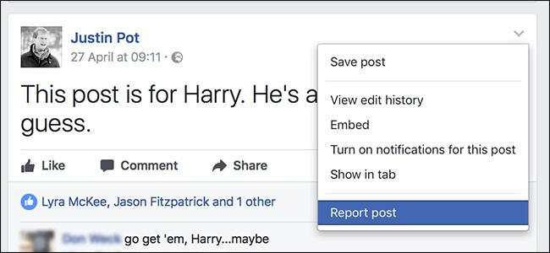
Facebook
Facebook is a social media website where users can post pictures and text for there friends and family to see.
Facebook was founded on February 4, 2004; 13 years ago by Mark Zuckerberg.
Facebook’s headquarters are located in Menlo Park, California
https://cdn.worldvectorlogo.com/logos/facebook-3.svg
https://www.howtogeek.com/306352/how-to-report-a-facebook-post/

Slide 22

Facebook Inside the Company
Facebook Hierarchy
Mark Zucckerberg: Founder, Chief Executive Officer
Sheryl Sandberg: Chief Operating Officer
Peter Thiel: Director
Jim Breyer: Director
https://www.wired.com/2017/05/mark-zuckerberg-really-listen/

Slide 23
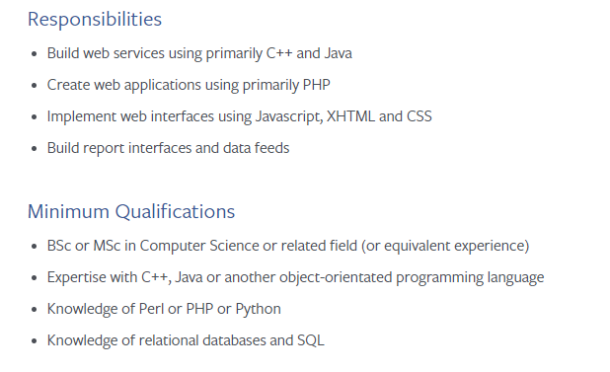
Facebook Jobs and Careers
Facebook has over 2000 job types available today, these jobs are located all over the globe. These jobs range from being a security project manager at Facebook headquarters to being a creative strategist in Hong Kong.
Facebook has a top rated work environment, friendly coworkers, and a great CEO.

Slide 24

Facebook Benefits
Maternity and Paternity Leave
Free Lunch if you work on location
Family Health Insurance Plan
https://blogordietryin.wordpress.com/2012/05/11/602/

Slide 25
Compare & Contrast
Name
Adobe
FaceBook
Twitter
Oracle
Air BNB
Amazon
Salaries
$100k-160k
$81k-$200k
$75k-$200k
$72k-$125k
$70k-$230k
$22k-$270k
Domain
Design
Social Media
Social Media
Software
Travel
E-Commerce
Education
B.S, M.S, PHD
B.S/M.S
B.S, M.S,PHD
HS - M.S
B.S./M.S.
B.S/B.A

Slide 26
Company Tier List
S++ - Facebook - 4.6 / 5 Stars, $80k - $200k
S+ - Adobe - 4.1 / 5 Stars - $100k - $160k Annual
S - Twitter - 4 / 5 Stars - $75k - $200k
A - AirBNB - 3.9 / 5 Stars, $70k - 230k /year
B - Amazon - 3.7 / 5 Stars, 32k - 270k
C - Oracle - 3.4 / 5 Stars, $70k-$230k/day

Slide 27
Questions?

Slide 28
Work Cited
https://www.pcworld.com/article/200290/who_runs_facebook.html
https://www.oracle.com/corporate/index.html#close
http://www.adobe.com/
https://www.facebook.com/careers/jobs/a0IA0000006cPEJMA2/
https://about.twitter.com/en_us/company.html/
https://www.glassdoor.com/Salary/Twitter-Salaries-E100569.htm/
https://www.amazon.com
https://en.wikipedia.org/wiki/Amazon_(company)
https://www.statista.com/statistics/266282/annual-net-revenue-of-amazoncom/
https://www.amazon.com
https://en.wikipedia.org/wiki/Amazon_(company)
https://www.statista.com/statistics/266282/annual-net-revenue-of-amazoncom/
https://research-methodology.net/amazon-organizational-structure-2/
https://www.amazon.jobs/en/job_categories/operations-it-support-engineering?offset=0&result_limit=10&sort=relevant&distanceType=Mi&radius=24km&latitude=&longitude=&loc_group_id=&loc_query=&base_query=&city=&country=&region=&county=&query_options=&

